Slide 1

JOB PORTAL
Group No. : 31
Vinayak Kamble (2BU19CS055)
Vishant Patil (2BU19CS056)
Under The Guidance of:
Prof. Sushiladevi B Vantamuri

Slide 2
CONTENTS
ABSTRACT
INTRODUCTION
METHODOLOGY
HARDWARE AND SOFTWARE REQUIREMENTS
FRONTEND AND BACKEND
ENTITY RELATIONSHIP DIAGRAM
SCHEMA DIAGRAM
ENTITY AND ATTRIBUTES
RESULT AND CONCLUSION

Slide 3
ABSTRACT:
Job Portal is a HTML5, CSS3, JavaScript ,MySQL and PHP based project, demonstrating the functionalities required to run a job listing website.
With the advent of internet , applying for jobs and getting a placement has become a hassle free task.
A job seeker can view thousands of jobs posted by employers and can apply for a job suiting his skills.
Job Portal enables an employer to post a job and can view information of enrolled job seekers, shortlist candidates for an interview and select best in industry candidates.
.

Slide 4
INTRODUCTION
Digitization has changed the game in the last decade and more so in the last 6 months. The world has seen and learnt how to use technology for business, leisure and entertainment. From ordering groceries online to working remotely with multiple companies across the globe, the internet has created new paths for employers and employees.

Slide 5
SYSTEM REQUIREMENTS
Software Requirements:
Apache server 2.0
PHP version 5.3 or above
MySQL version 5.0 or above
Latest browser(Chrome , Firefox etc)
Operating system(Windows , Mac ,Linux)
Hardware Requirements:
Ram 4 GB or above
Hard disk 2GB or above

Slide 6
FRONTEND:
Frontend:
HTML, CSS, JavaScript
HTML: HTML is used to create and save web document.
CSS : (Cascading Style Sheets) Create attractive Layout

Slide 7
BACKEND
PHP, MySQL
PHP: Hypertext Pre-processor (PHP) is a technology that allows software developers to create dynamically generated web pages, in HTML, XML, or other document types, as per client request. PHP is an open source software.
MySQL: MySQL is a database, widely used for accessing, querying, updating, and managing data in databases.

Slide 8
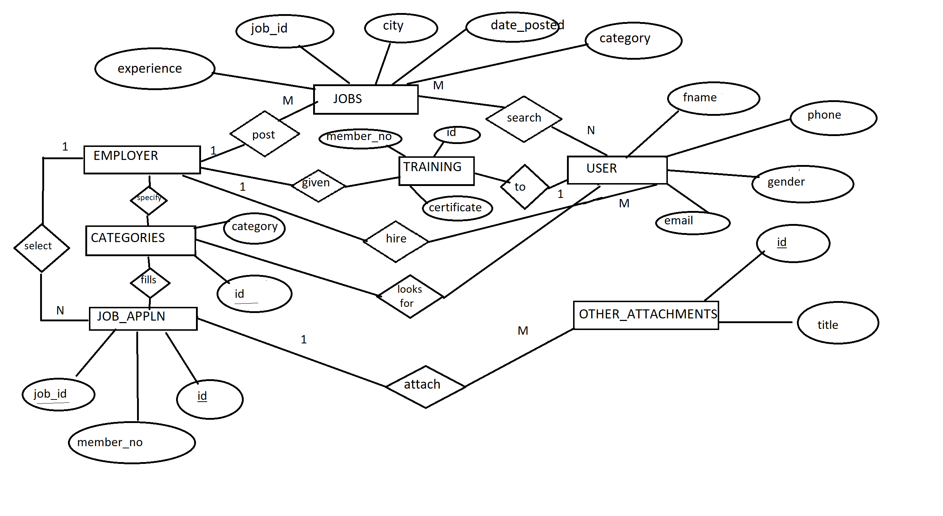
ENTITY – RELATIONSHIP DIAGRAM

Slide 9
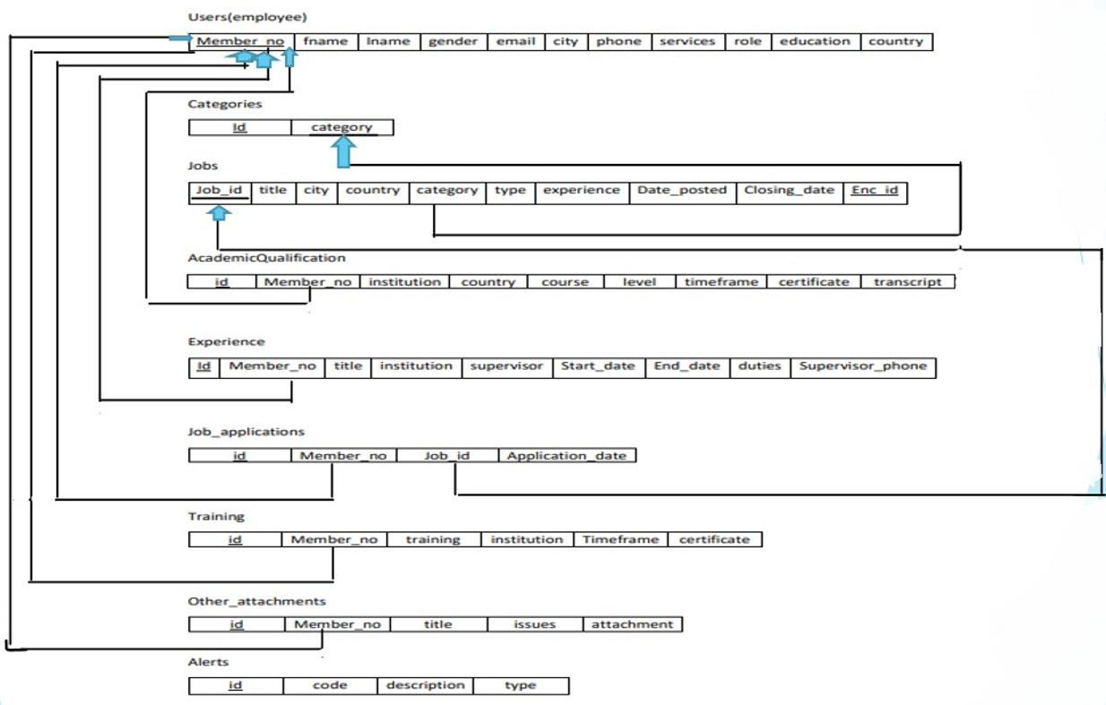
SCHEMA DIAGRAM

Slide 10

HOME PAGE

Slide 11
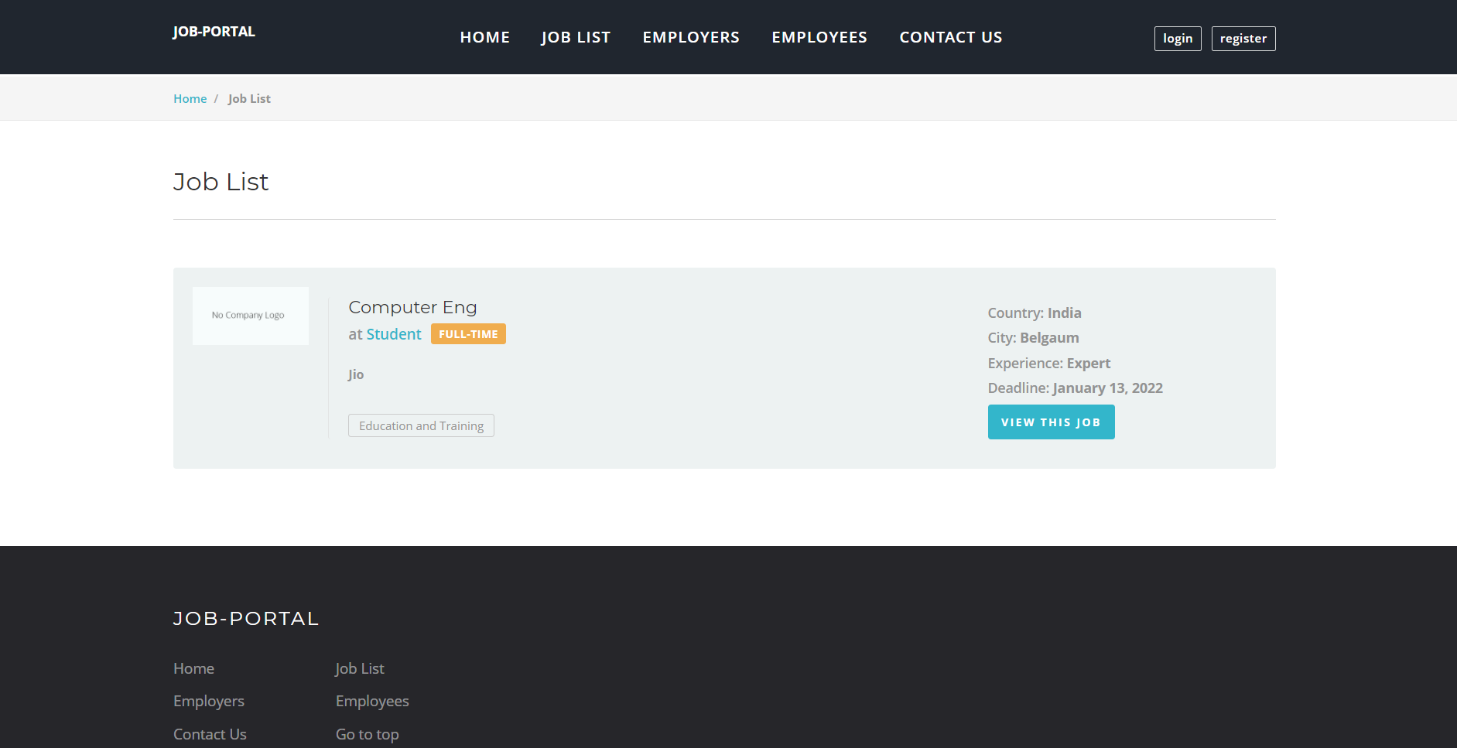
JOB-LIST:

Slide 12
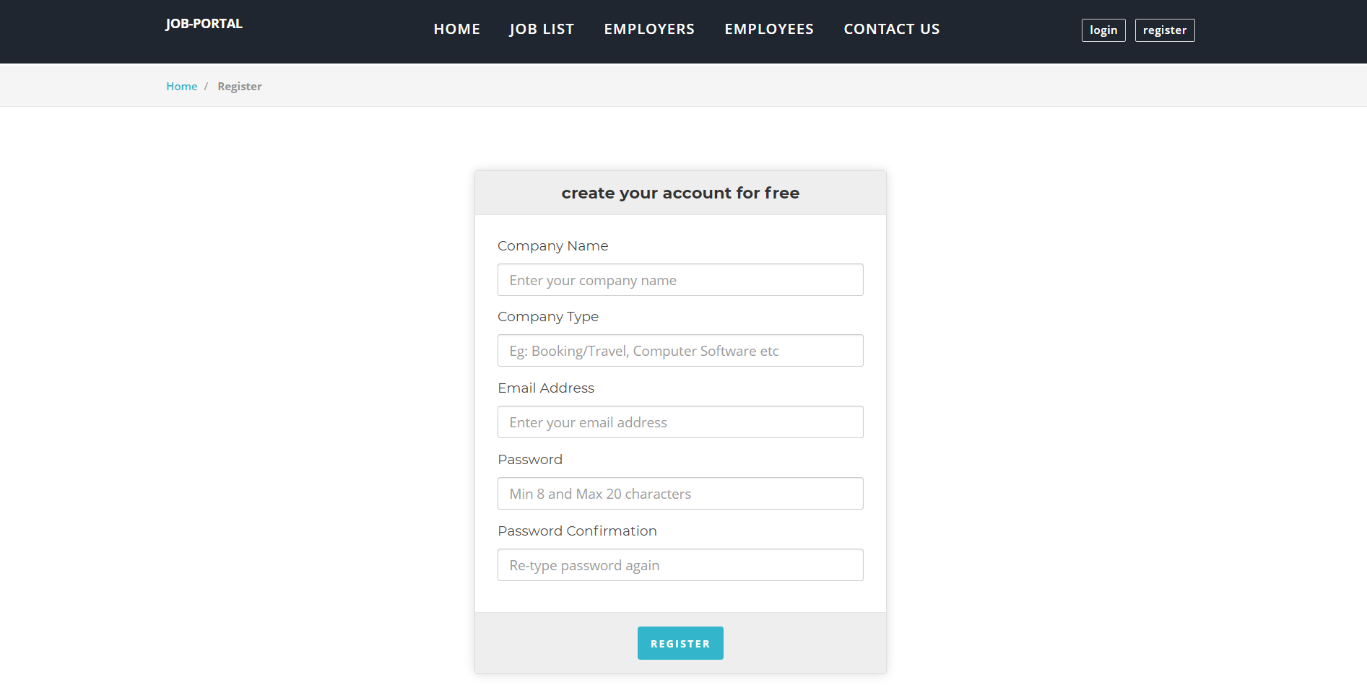
EMPLOYER REGISTRATION:

Slide 13
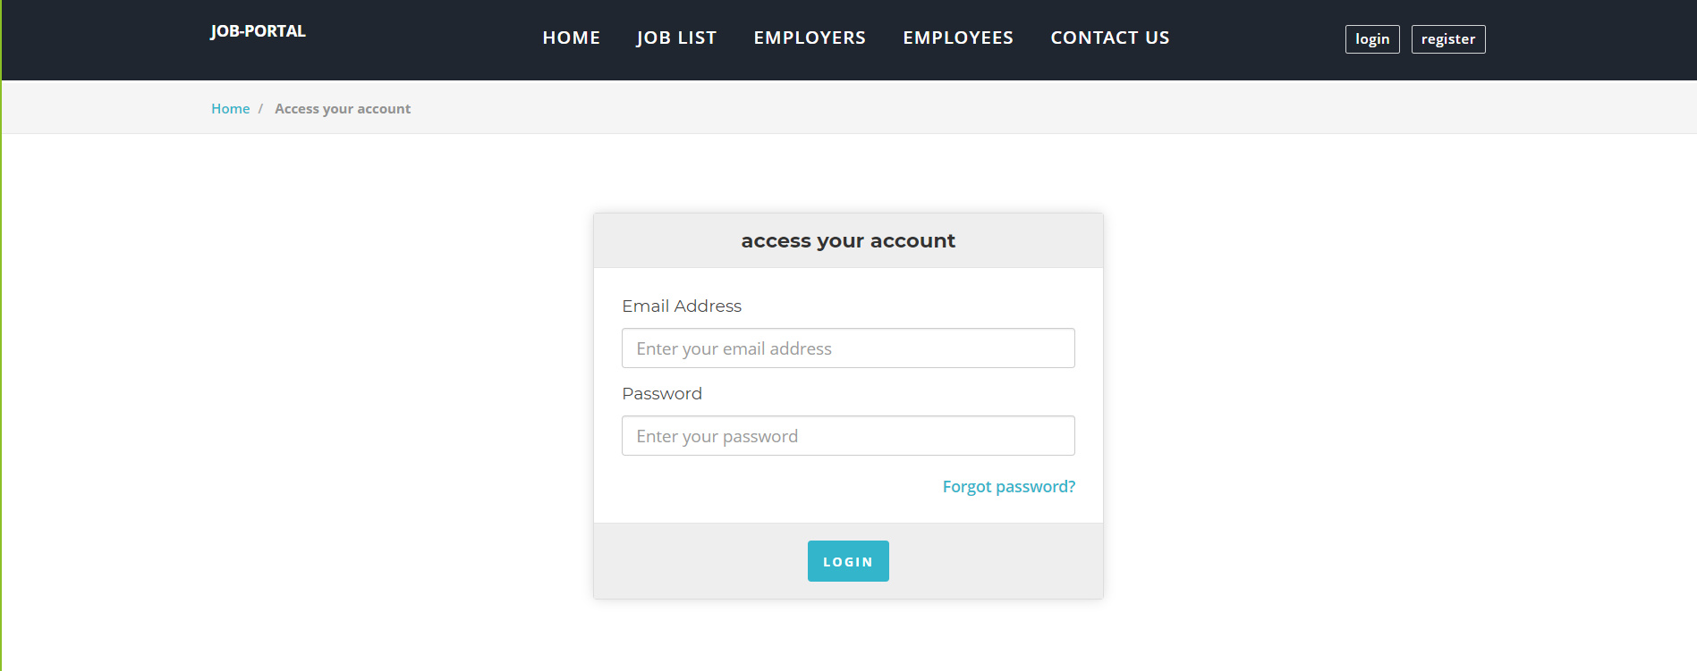
LOGIN:

Slide 14
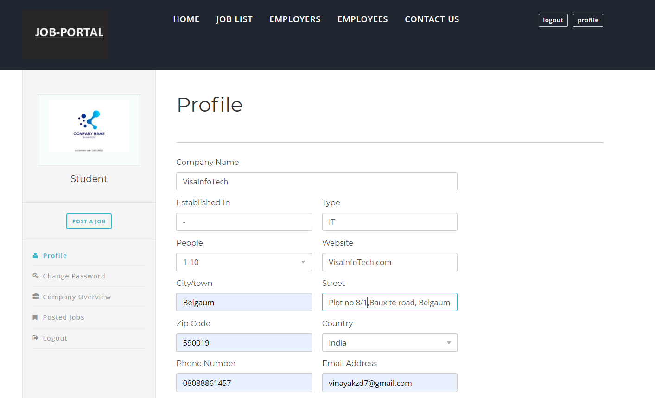
EMPLOYER PROFILE

Slide 15
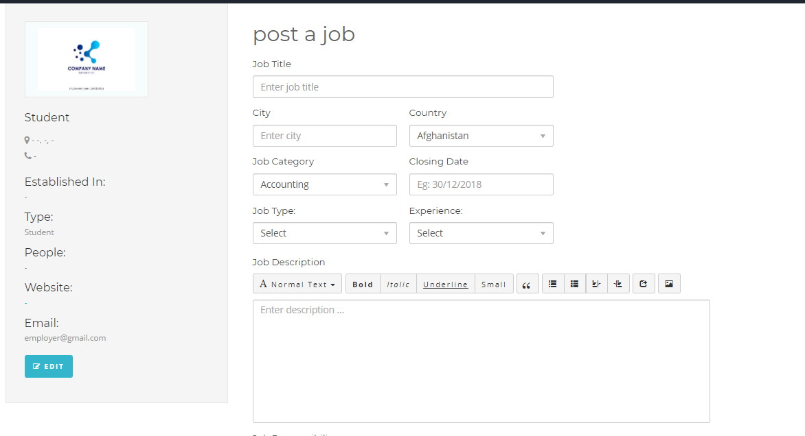
POSTING JOB:

Slide 16
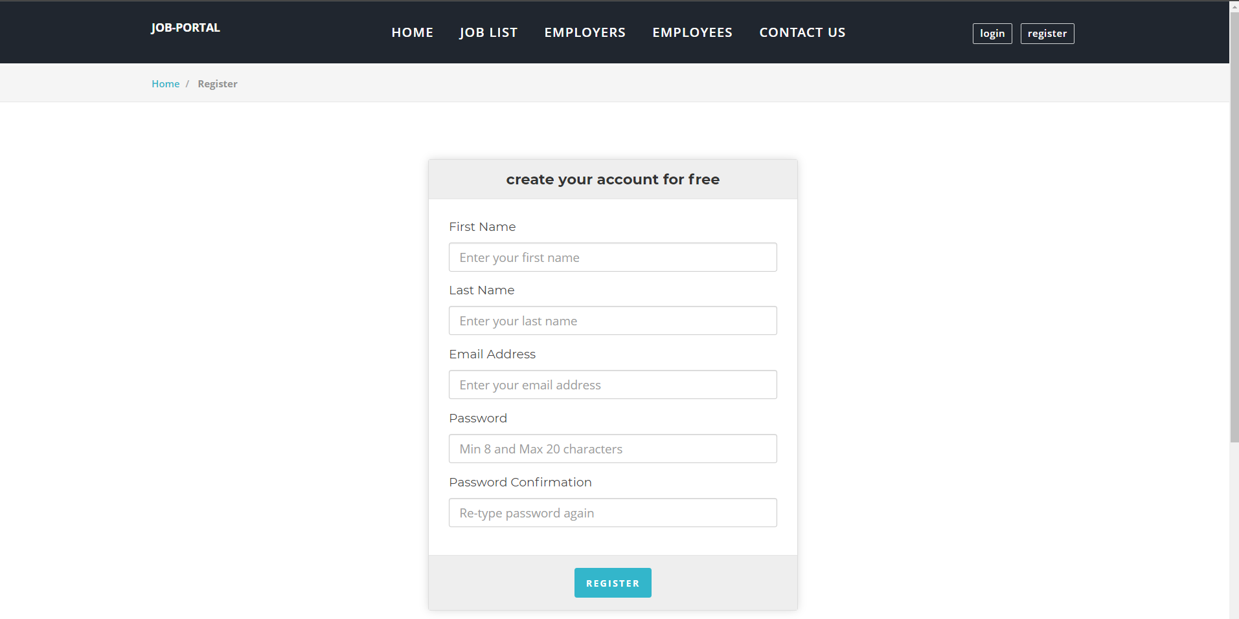
EMPLOYEE REGISTRATION:

Slide 17
LOGIN:

Slide 18
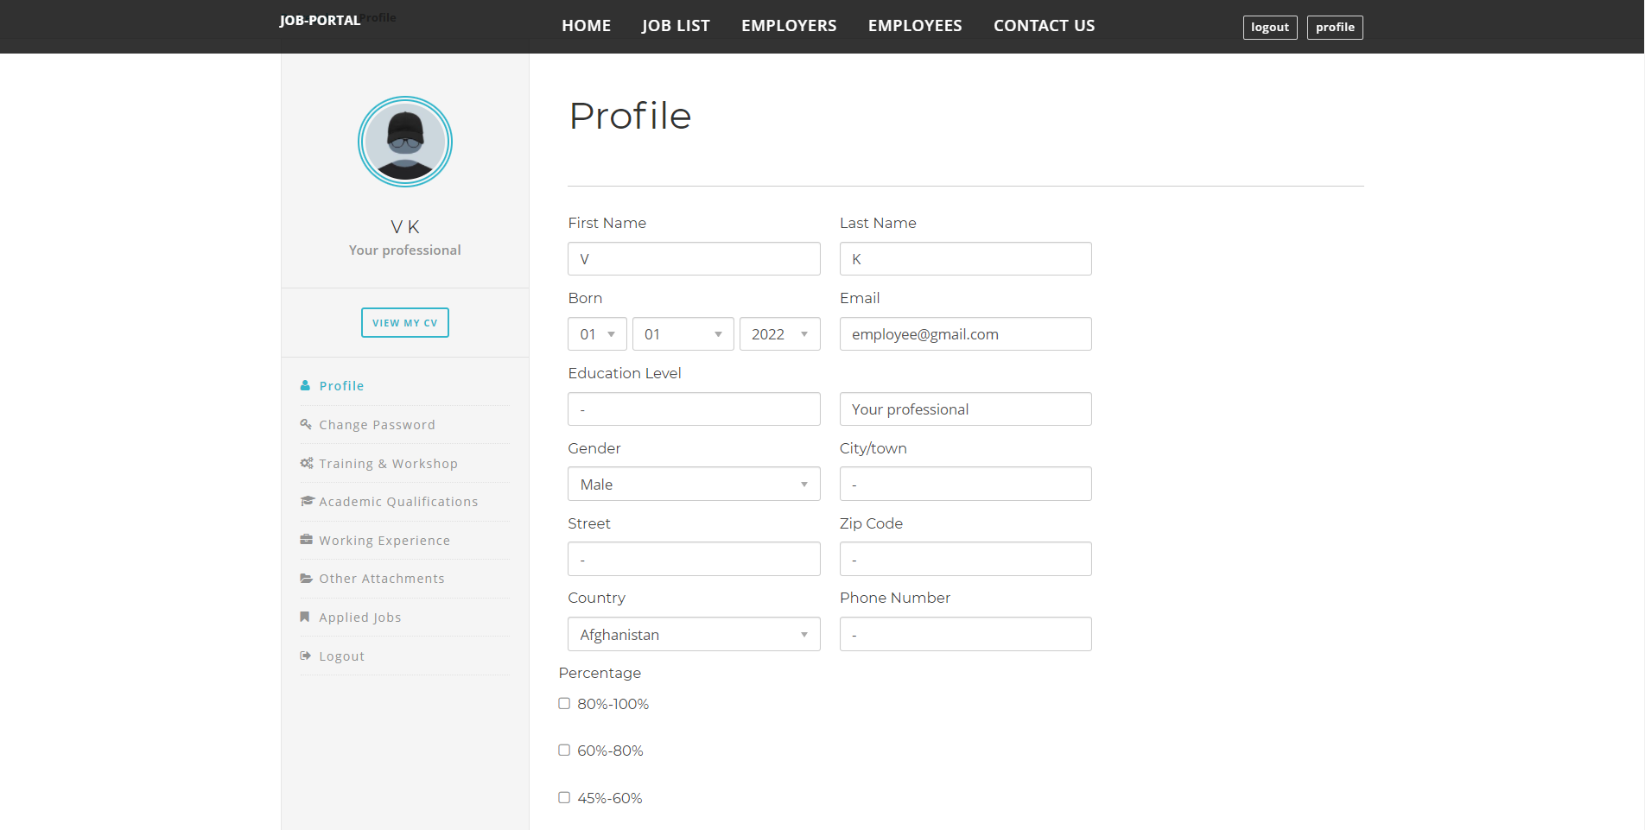
Employee Profile :

Slide 19
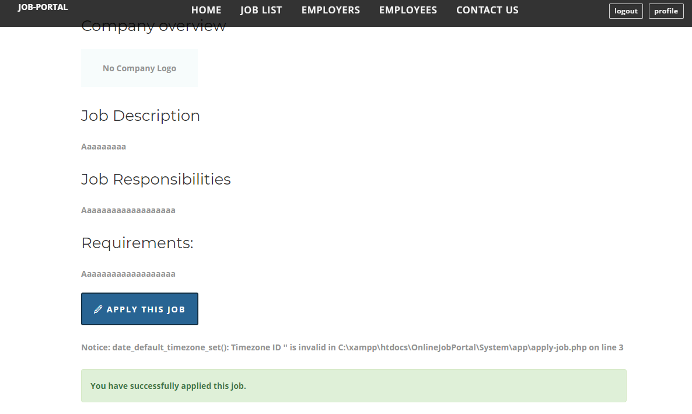
Employee Applying For Job :

Slide 20
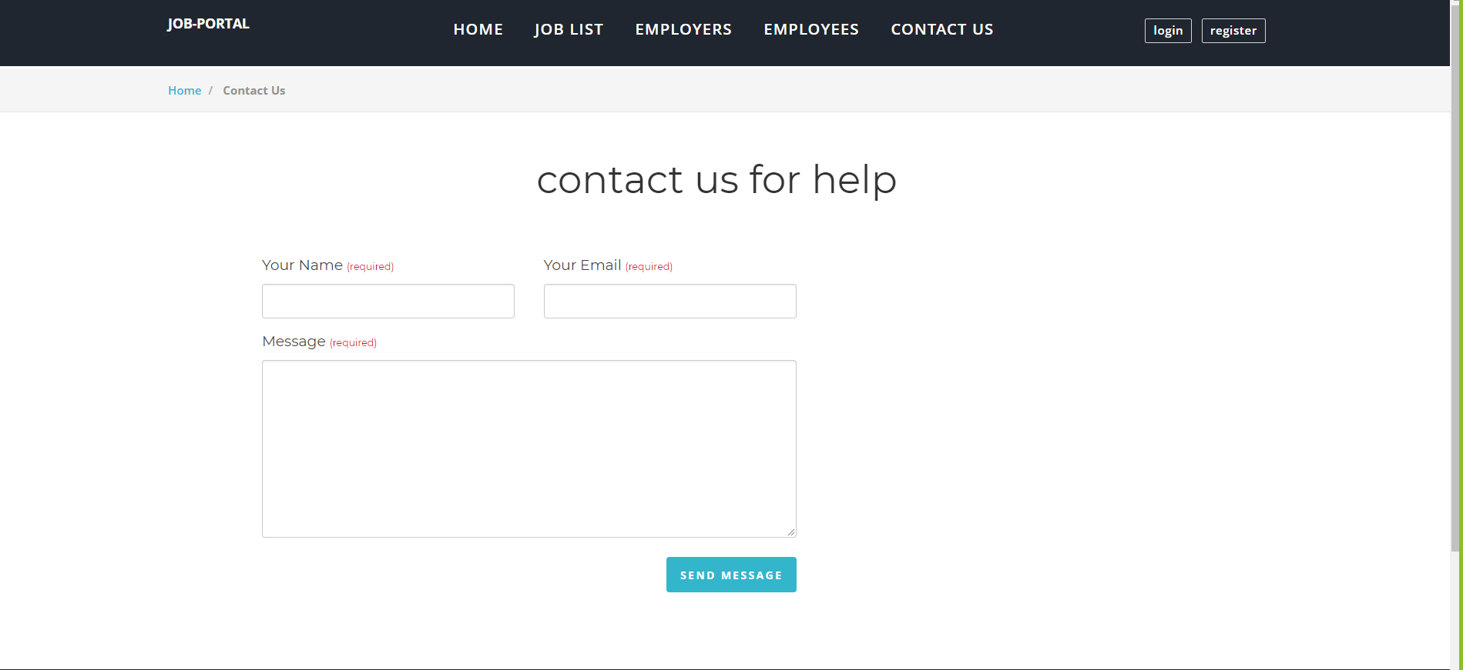
CONTACT US:

Slide 21
RESULT AND CONCLUSION
Computerized online Job Portal is developed to facilitate the to manage the various information of the Employee and Employers and the processes involved in a placement company. So, that organization can access accurate information quickly and easily as and when required, thereby improving its operational efficiency & effectiveness
Future Enhancement:
To increase the business of Client.
To make it Global.
To facilitate job search.
To facilitate company so that it can search for best candidates available.
To act as a middle men connecting Job seeker and Provider

Slide 22
THANK YOU

